Slide 1
Transport Your world pvt. ltd.
NIIT
Create By = Sumit Kumar Sharma , Yamini Madan And Sagar Kothari.

Slide 2
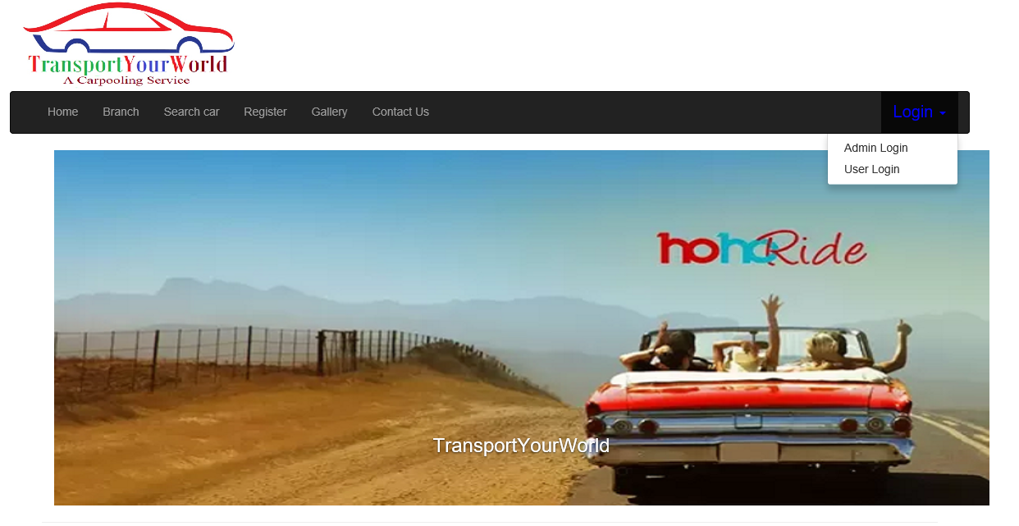
Transport your world
A Carpooling Service
Transport your world is a Delhi-base transport company ,Operating since 2010.

Slide 3
Home page
Register page
Gallery
Branch
Home
Admin login
Search Car
User login
Contact Us

Slide 4
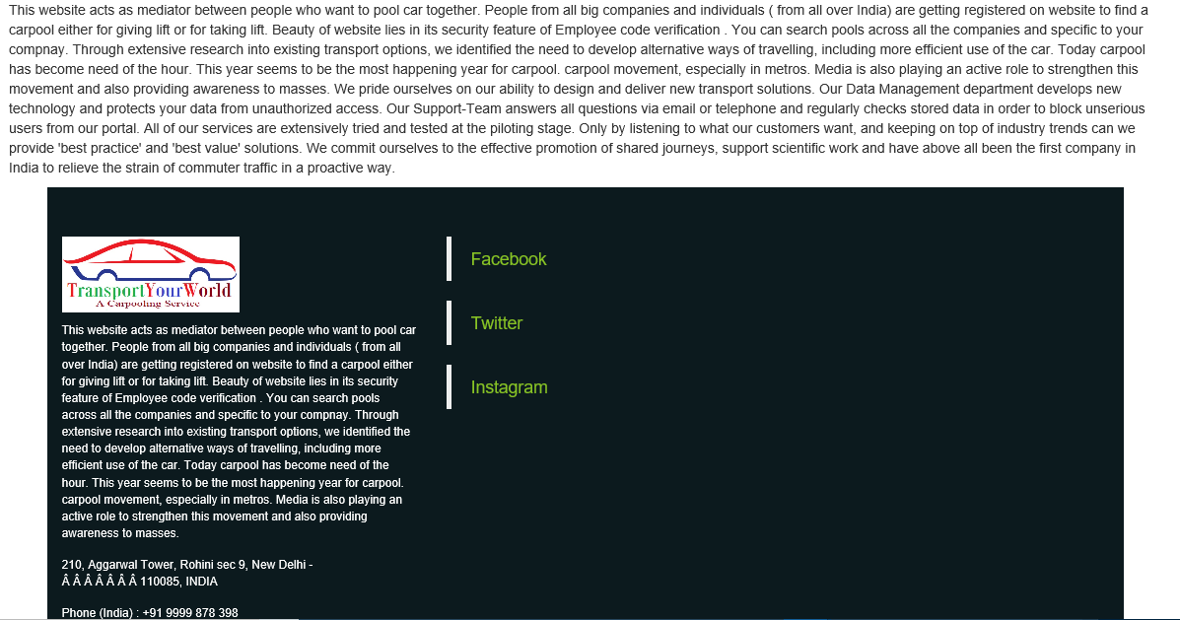
Info and contacts
It is over info and contacts page .
We provide address ,mobile number and email ..
And Social Network links like Facebook ,Twitter etc…

Slide 5
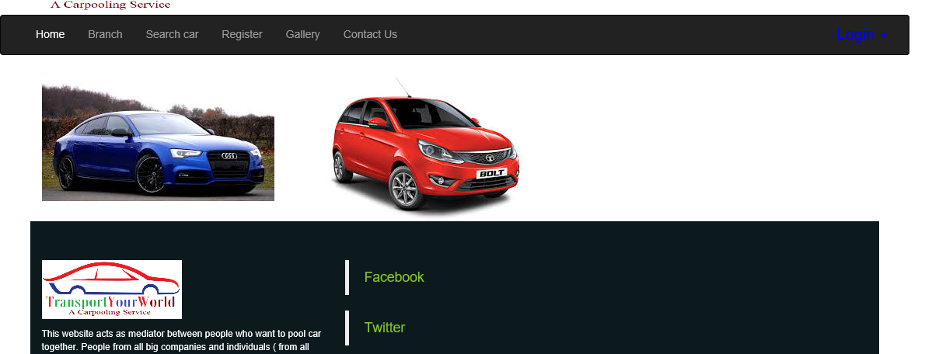
Gallery page
It is over Gallery page .
We provide cars pics .

Slide 6
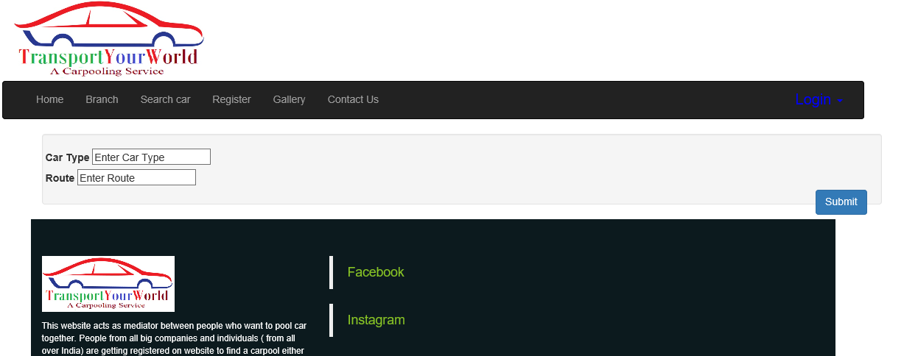
Search Car
It is over Search car page ..
We provide 2 option ..
Car Type.
Route.

Slide 7
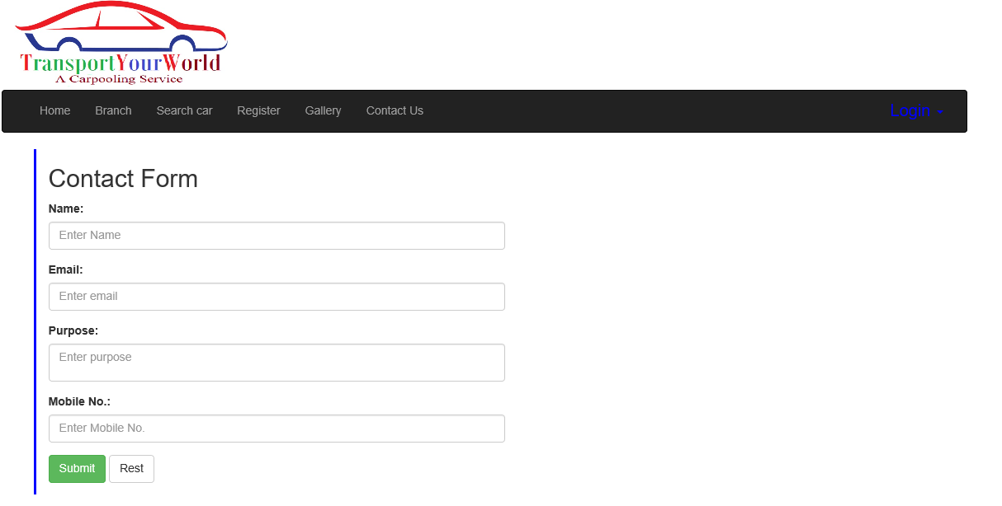
Register page
It is a Registration page .
We provide registration Colums .
Filled it and Register over website .
It is only User..

Slide 8
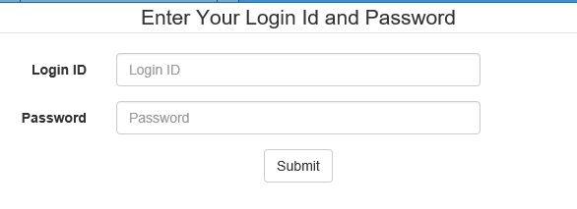
Login Page
Fill Id (Name)
It is a Login Page.
Enter name and password and click Submit button ..
For Login…
Fill Password

Slide 9
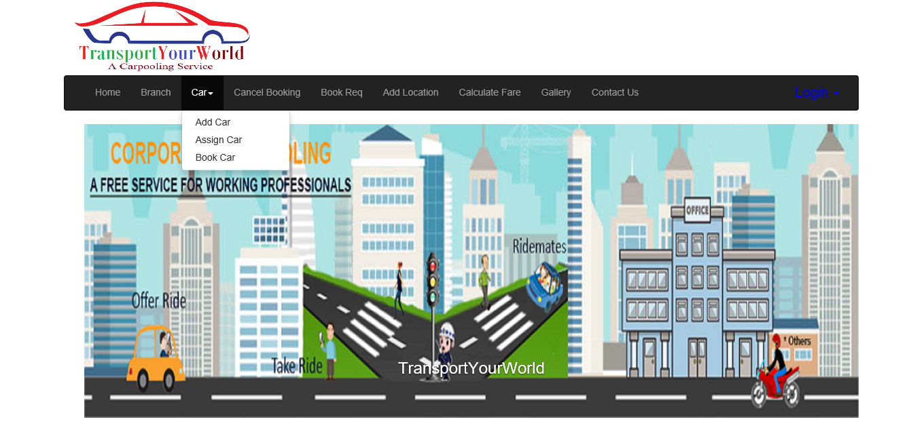
MAIN PAGE
After Login page …
After Login you provide many options like
1.Add Car.
2.Book Car .

Slide 10
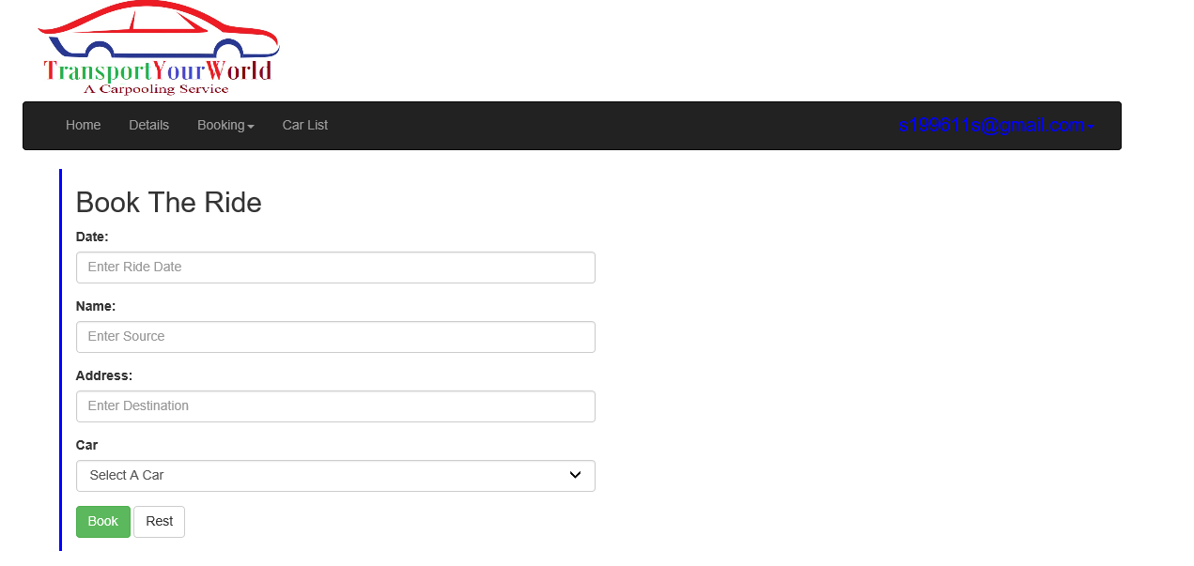
Book the ride
Booking page .
Enter details like
Date
Name
Address
Car
And click Book .
For Book Car……

Slide 11
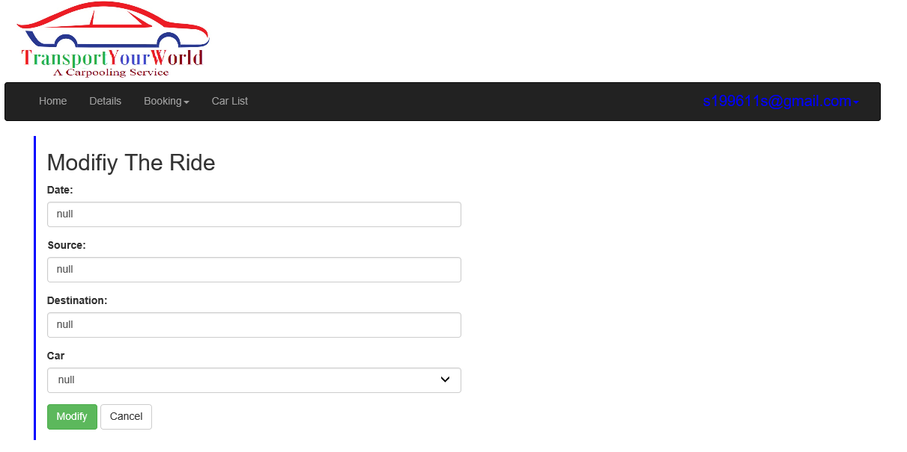
Modifiy the ride
Modifiy the ride page
Enter details to modifiy the ride ..
Than click Modify..

